Slide 1
Lesson objective
Title: Topic review 2
Aim- be able to:
Identify the requirements to set up a survey
Complete stratified sampling
Plan:
Stratified sampling
Creating surveys

Slide 2
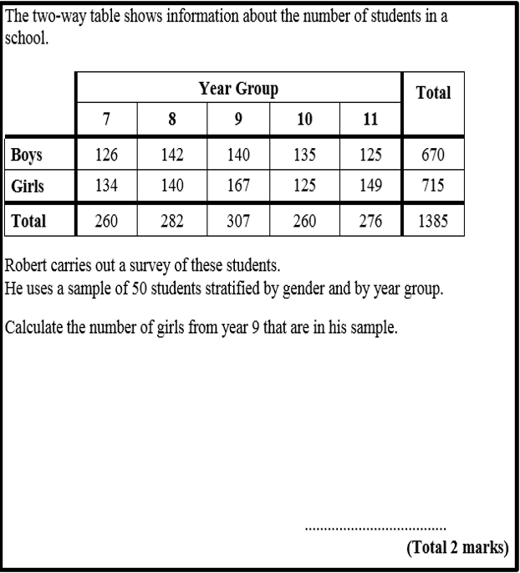
Divide members by total population
Multiply to sample amount (total number in survey)

Slide 3
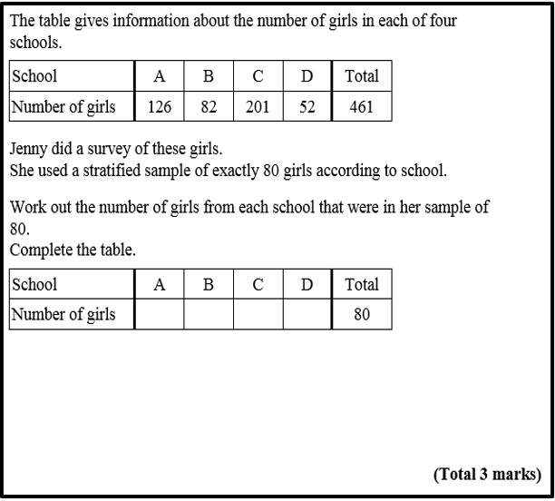
Divide members by total population
Multiply to sample amount (total number in survey)

Slide 4
Sample size
A sample survey size must include 10% or higher of the target population.
A sample survey size must include ____or higher of the target population.
A sample survey size must include ____or higher of the ______________.
How many people should be in a sample survey?

Slide 5
Sample size
There are 680 students in the school, if we did a sample survey what is the minimum number of students we should survey?
What is the issue if we survey 10 of the year 7 students?
What would happen if we get a larger sample? – what would happen if we did a census?

Slide 6
Setting up a survey
What we need:
Sample size (explain)
The question (unbiased – define question)
How will you select people?
How will you track the data? – why is that important?

Slide 7
Survey
Sample size (explain)
The question (unbiased – define question)
How will you select people?
How will you track the data? – why is that important?
Task: determine the favourite colour of the 150 year 8s at BSHS.

Slide 8
Survey
Sample size (explain)
The question (unbiased – define question)
How will you select people?
How will you track the data? – why is that important?
Task: Determine the average height of 250 year 12s.

Slide 9
Survey – you do
Sample size (explain)
The question (unbiased – define question)
How will you select people?
How will you track the data? – why is that important?
Task: .

